Slide 1

Wave Propagation in Muddy Sediments using Time Domain Finite Difference Approach
Author: Holly Clark
Date: May 2015
Supporting Authors: Ralph A. Stephen, Gopu R. Potty, James H. Miller
2pAO. Acoustics of Fine Grained Sediments: Theory and Measurements
[Work supported by ONR Code 322OA]
Notes:
Good Afternoon. Thank you all for sticking around for my presentation. I know these are long days but I promise not to bore you. My name is Holly Clark. I am a staff engineer at Applied Physical Sciences Corporation and I am also pursuing my masters degree in ocean engineering at the University of Rhode Island. My presentation today is on wave propagation in muddy sediments using time-domain finite-difference approach.
The guru’s supporting my work are Ralph Stephen from Woods Hole Oceanographic Institute, as well as Professor Gopu Potty and Professor Jim Miller from the University of Rhode Island.

Slide 2
Overview
Area of interest: New England Mud Patch south of Martha’s Vineyard
The model uses the two-dimensional full-wave time-domain finite-difference code developed at WHOI over the past 30 years.
Model Description
  Perfectly elastic, isotropic media with uniform step sizes in time and space.
  Source waveform is a Ricker wavelet with a peak frequency in pressure of 200 Hz
  100 m water waveguide (Vp = 1500 m/s, 1000 kg/m³) overlying 12 m of mud (Vp = 1530 m/s, Vs = 100 m/s, Rho = 1400 kg/m³) above a faster bottom (Vp = 1700 m/s, Vs = 500 m/s, Rho = 1800 kg/m³).
The goal of the modeling was to understand the propagation of compressional, shear and interface waves in the presence of a soft muddy layer
Notes:
There is a renewed interest in understanding wave propagation in muddy sediments. In this study we are using the time domain finite difference approach to investigate wave propagation in a muddy environment representative of the New England Mud Patch south of Martha’s Vineyard. The model uses the two-dimensional full-wave time-domain finite-difference code developed at WHOI over the past 30 years. In order to simplify the computation we consider perfectly elastic, isotropic media with uniform step sizes in time and space. The source waveform is a Ricker wavelet with a peak frequency in pressure of 200Hz. This study considers a 100 meter water waveguide (Vp = 1500 m/s) overlying 12 meters of mud (Vp = 1530m/s, Vs = 100m/s 1400kg/m^3) above a faster bottom (Vp = 1700m/s, Vs = 500m/s Rho = 1800 kg/m^3). The goal of the modeling was to understand the propagation of compressional, shear and interface waves in the presence of a soft muddy layer. [Work supported by ONR Code 3220A]

Slide 3
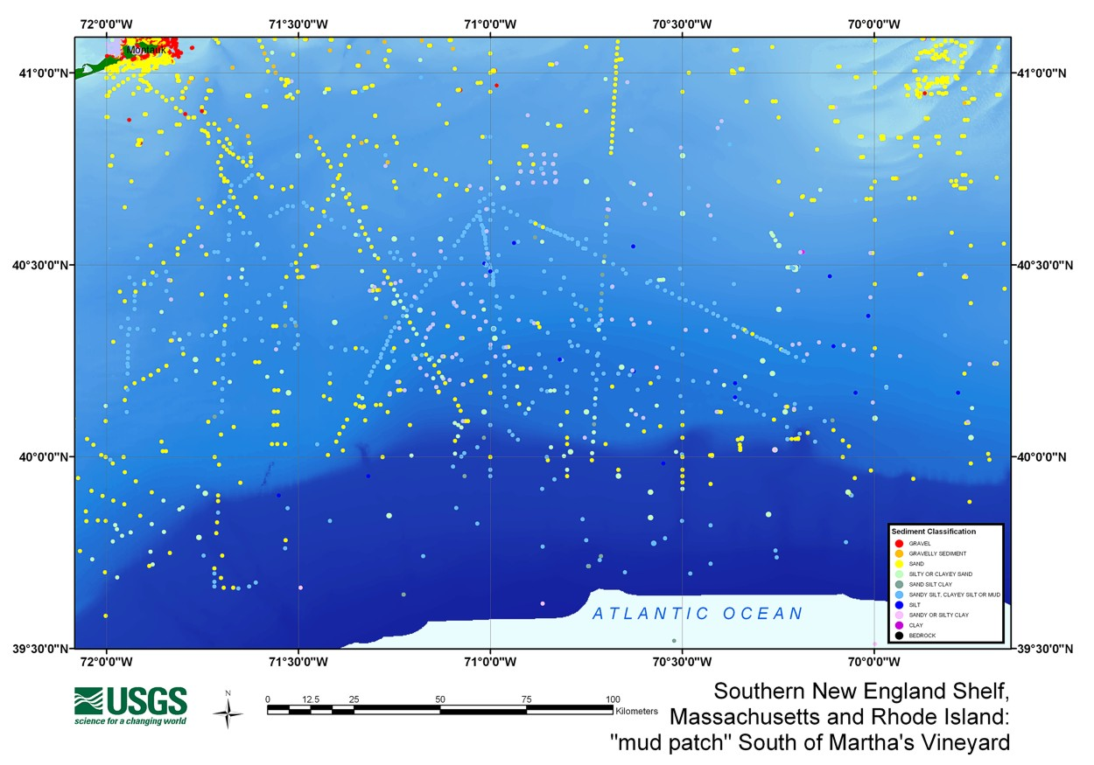
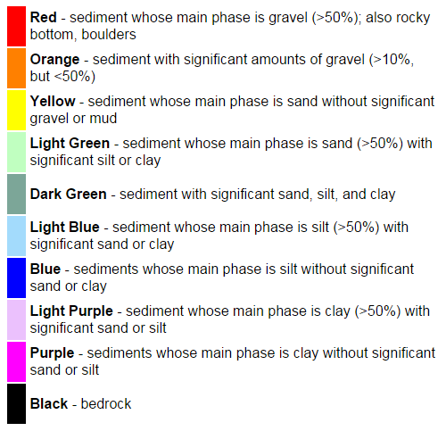
New England Mud Patch
http://pubs.usgs.gov/of/2003/of03-001/htmldocs/maps.htm
Notes:
So why are we doing this modeling work? Like I mentioned previously, there is a renewed interest in understanding wave propagation in muddy sediments. In particular, ONR has funded research and data collection efforts in the New England Mud Patch. As you can see from this geological survey, the Mud Patch is made up of predominately sediment whose main phase is silt both with and without sand or clay. Our modeling efforts will provide us with expected results for acoustic testing in this area, as well as in other geographically similar locations. The output of the model will also help researchers determine the best range positions for the acoustic hydrophones to measure the wavefronts of interest.

Slide 4
Code summary
Tdfd_grid.m
  Defines the physical models of interest
  Generates P-wave (compressional) and S-wave (shear) velocity files, and density files
FDREP
  Checks model parameters for validity
Source
  Ricker wavelet with peak frequency in pressure of 10Hz and 200Hz
FDBNY
  Calculates velocities within the boundary layer, allowing vertical and lateral heterogeneity in 2-D
FINDIF
  Outputs Snap-shots and time series data files
Plotting Software
  Snap-shots
  Time series
  Movies
Notes:
Here is a brief breakdown of the code we used. First, a short matlab code is used to define the physical model of interest. This matlab script generates the velocity and density files for the compressional and the shear.
The remainder of the wave propagation code is written in Fortran. There are many sub-routines, but in the interest of time we will only talk about a few main components.
The first program in the sequence FDREP checks the model parameters for validity and determines correct dimensions for the arrays needed by other programs.
The source is introduced as a compressional point source in space and a Ricker wavelet in time.
The second fortran program FDBNY finds the matrices of P_ and S_ velocity squared and the density matrix of the boundary layer for the model. It computes solutions for rough interfaces and volume heterogeneity in two dimensions. For our model we assumed a flat bottom.
The final program FINDIF uses the model parameter file and the files produced by the other two programs to create the final output.
Then there is the plotting software. The snap-shot files give values of vertical displacement over the entire grid at the specified times. The times series gives values of vertical displacement, horizontal displacement, or pressure at each of the selected grid points for a specified time interval. I have also made a few movies of the snapshot outputs using windows live movie maker.

Slide 5

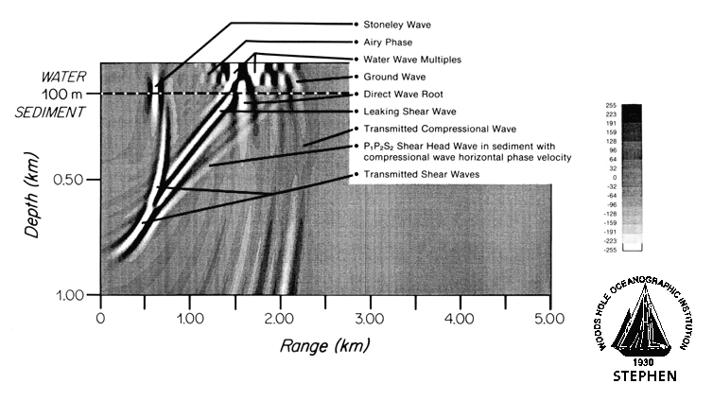
Original Example
Notes:
This is a figure from Ralph Stephen’s website at WHOI. This picture was created about 1995 and shows the wave types excited by a 10Hz source in 100m water layer over a sandy bottom. The figure is labeled and we can see the different types of P & S waves in the model. The Stonley ( or Scholte wave) is the slowest moving wave front. In front of the scholte wave we see the transmitted shear waves, the leaking shear wave, and the shear head wave in the sediment. And out front we can see the transmitted compressional wave. This model is 5km long by 1km deep. It took a long time to run. We were interested in creating a model that was approximately 5 times smaller scale with a Ricker wavelet source pinging at 20 time the frequency.

Slide 6
Original example
Model Name | HCC08
Frequency | 10 Hz
Water Depth | 100 m
Sediment Layer 1 | Linear Sand Gradient
Width | 900m
Compressional Velocity | 2000-2250 m/s
Shear Velocity | 680-760 m/s
Density | 2000-2100 kg/m^3
Overall Model Depth | 1000m
Overall Model Range | 5000 m
Source Depth | 50 m
100m
Source
water
250m
hard sediment gradient
100m
Source
water
250m
hard sediment gradient
100m
Source
water
250m
hard sediment gradient
Notes:
The first step to our model was to recreate the large lower frequency model that Ralph had posted on the WHOI website. Here is a slide showing the velocity and density profiles for the model. On top there is 100 m of seawater. The source is a Ricker wavelet pinging at 10Hz and it is located mid water column at 50 m. Below the water layer is a hard sediment linear gradient. The compressional velocity gradient starts at 2000 m/s at the top and ends at 2250 m/s at the bottom, which is 250 m below the water/sediment interface. The shear velocity gradient runs from 680 m/s to 760 m/s and the density gradient from 2000 kg/m^3 to 2100 kg/m^3.

Slide 7
Source depth dependence and interface waves
Three examples:
  1/60th water wavelength above the seafloor
  1/10th water wavelength above the seafloor
  1 water wavelength above the seafloor
Notes:
A large portion of my studies went to learning how to modify Ralph’s code for our particular purpose. A big thanks to both Ralph Stephen and Tom Bolmer up at WHOI for working so patiently with me while I learned the ins and outs of the code. So, the first step in modifying the WHOI code was to downsize the model space. Since the model had been used for full ocean studies we had to first had to create something more representative of the New England Mud Patch. We wanted to study smaller features so we also increased the frequency of the source wavelet from 10Hz to 200Hz. During analysis, it was noticed that the placement of the source had an effect on the response of the wave propagation in the bottom sediment; in particular, the Scholte wave. We will look at three examples. The first example with the source at 1/60th of a water wavelength above the seafloor. The second at 1/10th water wavelength and the third at 1 water wavelength above the seafloor. And just to clarify, one water wavelength at 200 Hz is 7.5 m.

Slide 8
Source located 1/60 water wavelength above sediment layer
Model Name | Hcc12
Frequency | 200 Hz
Water Depth | 100 m
Sediment Layer 1 | Hard Sediment
-Width | 110 m
-Compressional Velocity | 1700 m/s
-Shear Velocity | 500 m/s
-Density | 1800 kg/m^3
Overall Model Depth | 215m
Overall Model Range | 500 m
Source Height Above Sediment | .125 m
Notes:
The purpose of the next few slides is to show how the results differ for various source depths. All three models have a homogenous layer of water above a hard sediment half-space. The water layer is 100 meters deep with a compressional velocity of 1500m/s. The hard sediment half-space has a compressional velocity of 1700 m/s, a shear velocity of 500m/s and a density of 1800 kg/m^3. The source in this model was placed 1/60th of a water wavelength or .125m above the seafloor.

Slide 9

Source located 1/60 water wavelength above sediment layer
Sea Surface Reflection
Direct Water Wave
Compressional Head Wave
Direct Wave Root
Transmitted Compressional Wave
Source located 1/60th of a water wavelength (.125m) above water/sediment interface
Scholte Wave
Leaking Shear Wave
P1P2S2 Shear Head Wave
Evanescently Generated Shear Waves
Notes:
When the source is placed 1/60th of a water wavelength above the seafloor, we see all of the wavefronts of interest. The Scholte wave is shown on both the compressional and shear plots. The Compression head wave, transmitted compressional wave and direct wave root are all seen on the compressional plot. The leaking shear wave and the P1P2S2 Shear head wave are present on the shear plot. The Scholte wave, shown on both the compressional and shear plots, and the evanescently excited shear wave are generated when the source is very close to the seafloor. (P1S1S2 Shear head wave in sediment with compressional wave horizontal phase velocity –P1S1S2 is Brekhovskikh nomenclature)

Slide 10
Source located 1/10 water wavelength above sediment layer
Model Name | Hcc13
Frequency | 200 Hz
Water Depth | 100 m
Sediment Layer 1 | Hard Sediment
-Width | 110 m
-Compressional Velocity | 1700 m/s
-Shear Velocity | 500 m/s
-Density | 1800 kg/m^3
Overall Model Depth | 215m
Overall Model Range | 500 m
Source Height Above Sediment | .75 m
Notes:
The second model displayed a test case with the source slightly farther away from the seafloor. In this model the source is located 1/10th of a water wavelength, or .75m above the seafloor. All other parameters are the same as the previous model.

Slide 11
Source located 1/10 water wavelength above sediment layer
Sea Surface Reflection
Direct Water Wave
Compressional Head Wave
Transmitted Compressional Wave
Direct Wave Root
Source located 1/10th of a water wavelength (.75m) above water/sediment interface
Scholte Wave
Leaking Shear Wave
P1P2S2 Shear Head Wave
Evanescently Generated Shear Waves
Notes:
We can still see all the wavefronts of interest; however, the Scholte wave and evanescently excited shear wave are weaker than for the 1/60th model. The other wavefronts remained pretty strong regardless the source height. Let’s look at the last example.

Slide 12
Source located 1 water wavelength above sediment layer
Model Name | Hcc14
Frequency | 200 Hz
Water Depth | 100 m
Sediment Layer 1 | Hard Sediment
-Width | 110 m
-Compressional Velocity | 1700 m/s
-Shear Velocity | 500 m/s
-Density | 1800 kg/m^3
Overall Model Depth | 215m
Overall Model Range | 500 m
Source Height Above Sediment | 7.5 m
Notes:
In this example, the source was located 1 water wavelength, or 7.5 meters, above the seafloor. Like the prior example, all other model parameters remained the same.

Slide 13
Source located 1 water wavelength above sediment layer
Sea Surface Reflection
Direct Water Wave
Compressional Head Wave
Direct Wave Root
Transmitted Compressional Wave
SIGNIFICANTLY REDUCED Scholte Wave & Evanescently Generated Shear Wave
Source located a water wavelength (7.5m) above water/sediment interface
Leaking Shear Wave
P1P2S2 Shear Head Wave
Evanescently Generated Shear Waves
Notes:
We see now, with the source 1 full water wavelength above the seafloor that the Scholte and evanescently generated shear waves are significantly reduced. So for our muddy environment example, and any other 200Hz examples we want to run, it is suggested to have the source located within 1/10th of a water wavelength above the seafloor.

Slide 14
Muddy Environment Example
Model Name | Hcc21
Frequency | 200 Hz
Water Depth | 100 m
Sediment Layer 1 | Mud
Width | 12 m
Compressional Velocity | 1530 m/s
Shear Velocity | 100 m/s
Density | 1400 kg/m^3
Sediment Layer 2 | Hard Sand
Width | 100 m
Compressional Velocity | 1700 m/s
Shear Velocity | 500 m/s
Density | 1800 kg/m^3
Overall Model Depth | 216m
Overall Model Range | 500 m
Source Depth | .125 m above seafloor
0
100
250
0
100
250
0
100
250
Notes:
Once the size of the model was reduced and we found an optimal location for the source, we investigated adding in a muddy layer above the hard sediment. In an attempt to represent the New England Mud Patch, the mud layer was 12 meters deep with a compressional wave velocity of 1530 m/s, a shear velocity of 100m/s and a density of 1400kg/m^3. This was over a faster homogeneous half-space with a compressional velocity of 1700m/s, and a shear velocity of 500m/s, and a density of 1800kg/m^3. The water depth remained at 100 meters.

Slide 15
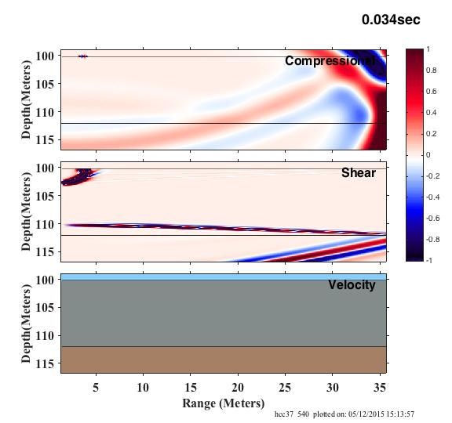
Zoom View
Scholte Wave
Evanescently Generated Shear Waves
Converted Shear Wave Reflection
Notes:
Here is a zoomed in view of the mud layer. The mud layer is from 100 m to 112 m. You can see the sholte wave on both plots. There is also an evanescently generated shear wave just below the Scholte wave. The snap shot was taken at a slightly earlier time step, so the converted shear wave reflection hasn’t reached the evanescently generated shear wave. This model in particular will prove to be very helpful in predicting expected results for acoustic tests in a muddy environment.

Slide 16
Summary
Location of source needs to be within 1/10 water wavelength to see significant Scholte wave and evanescently transmitted shear wave
Scholte wave and the evanescently transmitted shear wave are significantly weaker in mud layer model
There are converted shear wave reflections generated from the mud/harder sediment boundary layer

Slide 17
References
Stephen, R. A. (1983). "A comparison of finite difference and reflectivity seismograms for marine models," Geophys. J. R. Astron. Soc. 72, 39-57.
Stephen, R. A. (1991). "Finite difference modelling of shear waves," in Shear Waves in Marine Sediments, edited by Hovem, J. M., Richardson, M. D. and Stoll, R. D. (Kluwer, Dordrecht), 471-478.
Stephen, R. A. (1993). "A numerical scattering chamber for studying reverberation in the seafloor," in Ocean Reverberation, edited by Ellis, D. D., Preston, J. R. and Urban, H. G. (Kluwer, Dordrecht), 227-232.
Stephen, R. A. (1996). "Modeling sea surface scattering by the time-domain finite difference method," J. Acoust. Soc. Am. 100, 2070-2078.
Stephen, R. A. (2000). "Optimum and standard beam widths for numerical modeling of interface scattering problems," J. Acoust. Soc. Am. 107, 1095-1102.
Stephen, R. A., and Swift, S. A. (1994). "Modeling seafloor geoacoustic interaction with a numerical scattering chamber," J. Acoust. Soc. Am. 96, 973-990.
Swift, S. A., and Stephen, R. A. (1994). "The scattering of a low-angle pulse beam by seafloor volume heterogeneities," J. Acoust. Soc. Am. 96, 991-1001.
Brekhovskikh, L. M. (1960). Waves in Layered Media, (Academic, New York).

Slide 18
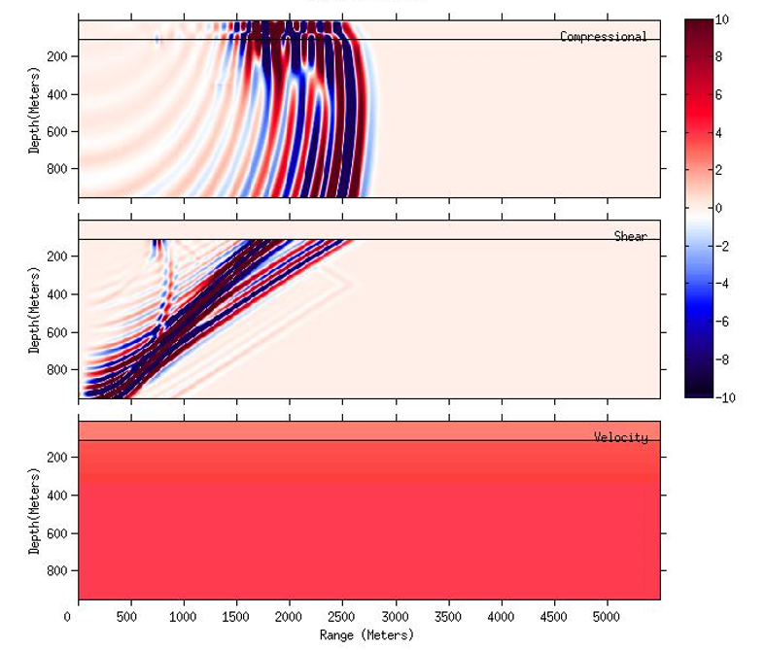
Original example
Ground Wave
Airy Phase
Direct Wave Root
Transmitted Compressional Wave
Stoneley Wave
Source at 50m above sediment
Leaking Shear Wave
P1P2S2 Shear Head Wave in sediment with compressional wave horizontal phase velocity
Evanescently Generated Shear Waves
Homogeneous Water
Vp = 1.5km/s, Rho = 1000kg/m^3
Gradient Sediment
Vp = 2 -2.25km/s, Vs = .68 -.76km/s, Rho = 2000- 2100kg/m^3
Homogeneous Sediment
Vp = 2,250m/s
Vs = 760m/s
Rho = 2100kg/m^3

Slide 19
Muddy environment example
Direct Water Wave
Compressional Head Wave
Direct Wave Root
Transmitted Compressional Wave
Scholte Wave
Converted Shear Wave Reflection
Leaking Shear Wave
P1P2S2 Shear Head Wave
Notes:
Although it is hard to see, there is a Stonely Wave generated in the mud layer. It is significantly reduced compared to No evanescently generated shear waves.

Slide 20
Notes
Pressure and vertically polarized shear (PSV) – Scholte is this type of wave

